Slide 1
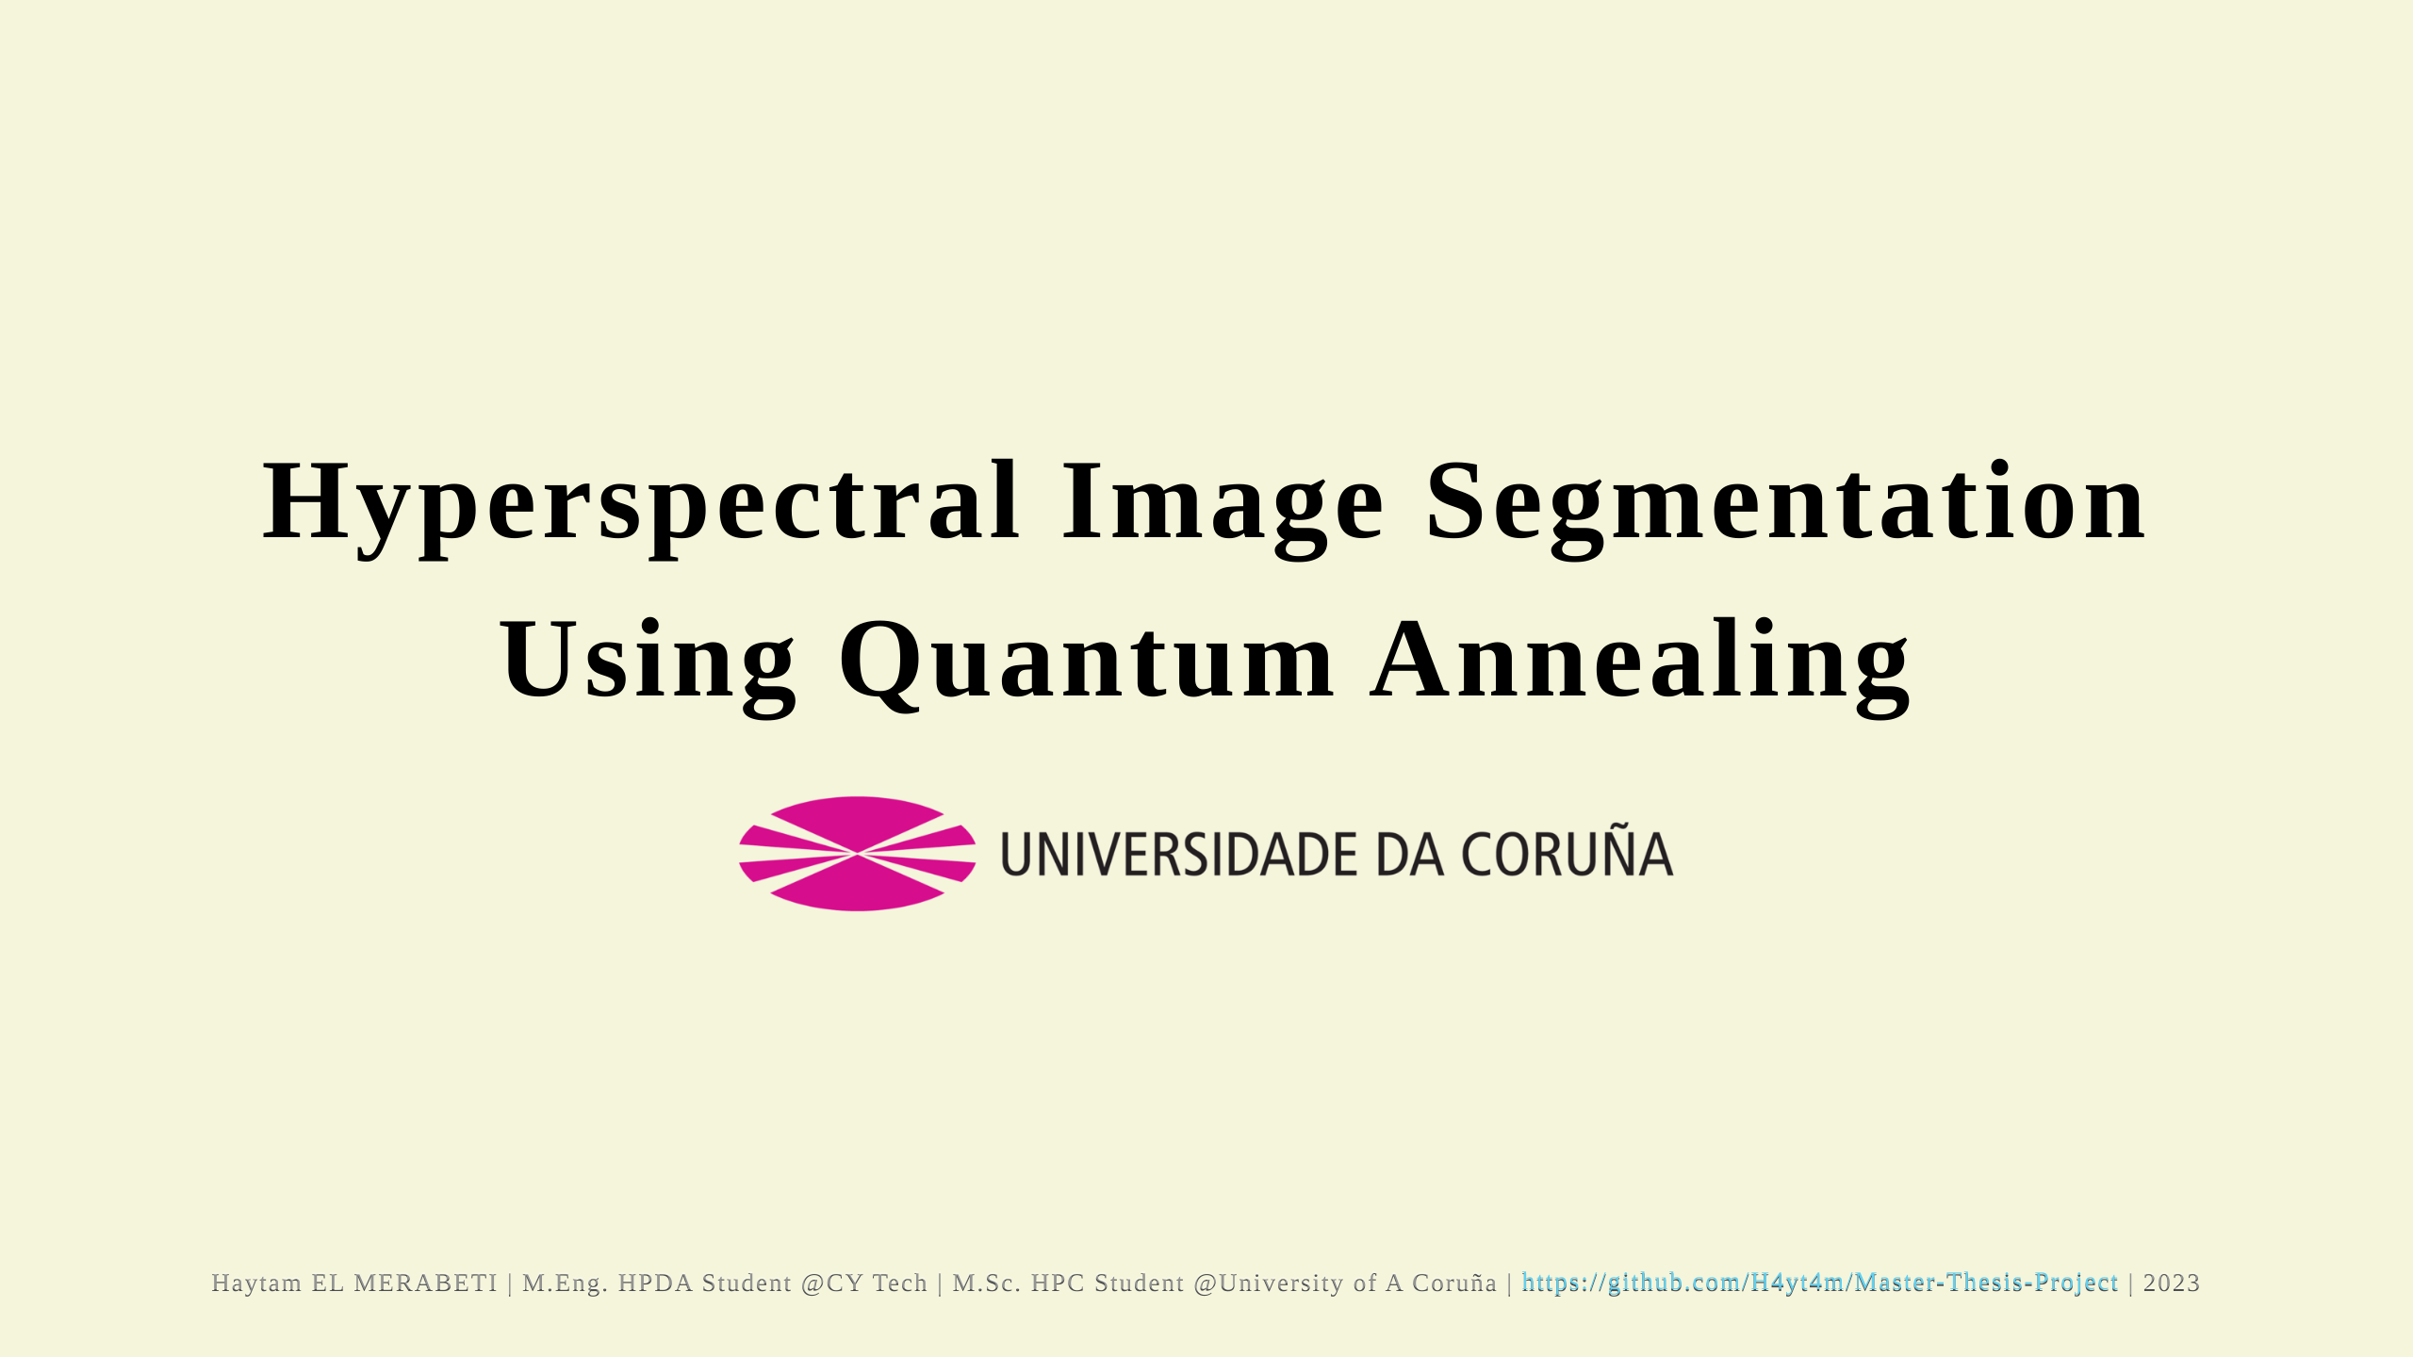

Slide 2
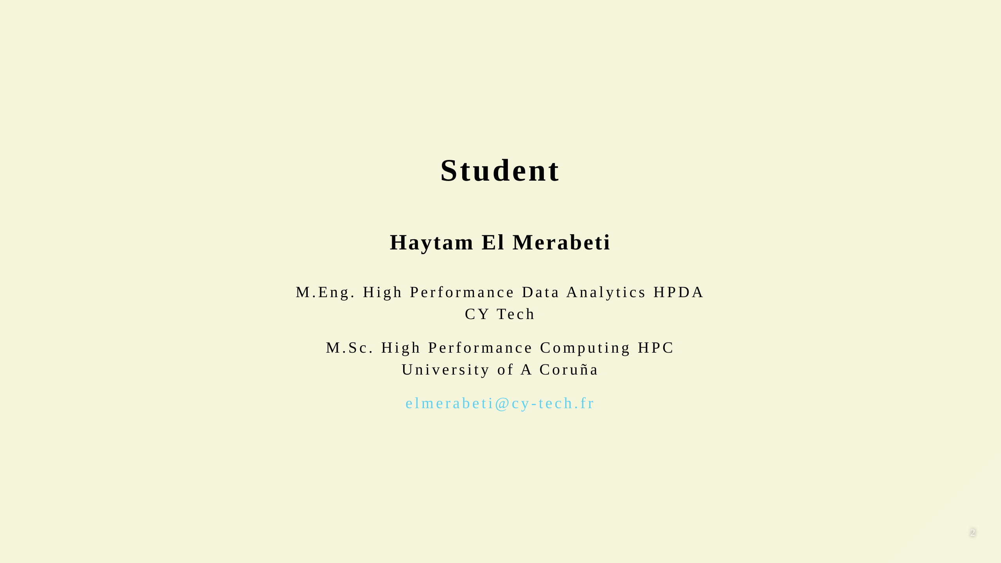

Slide 3
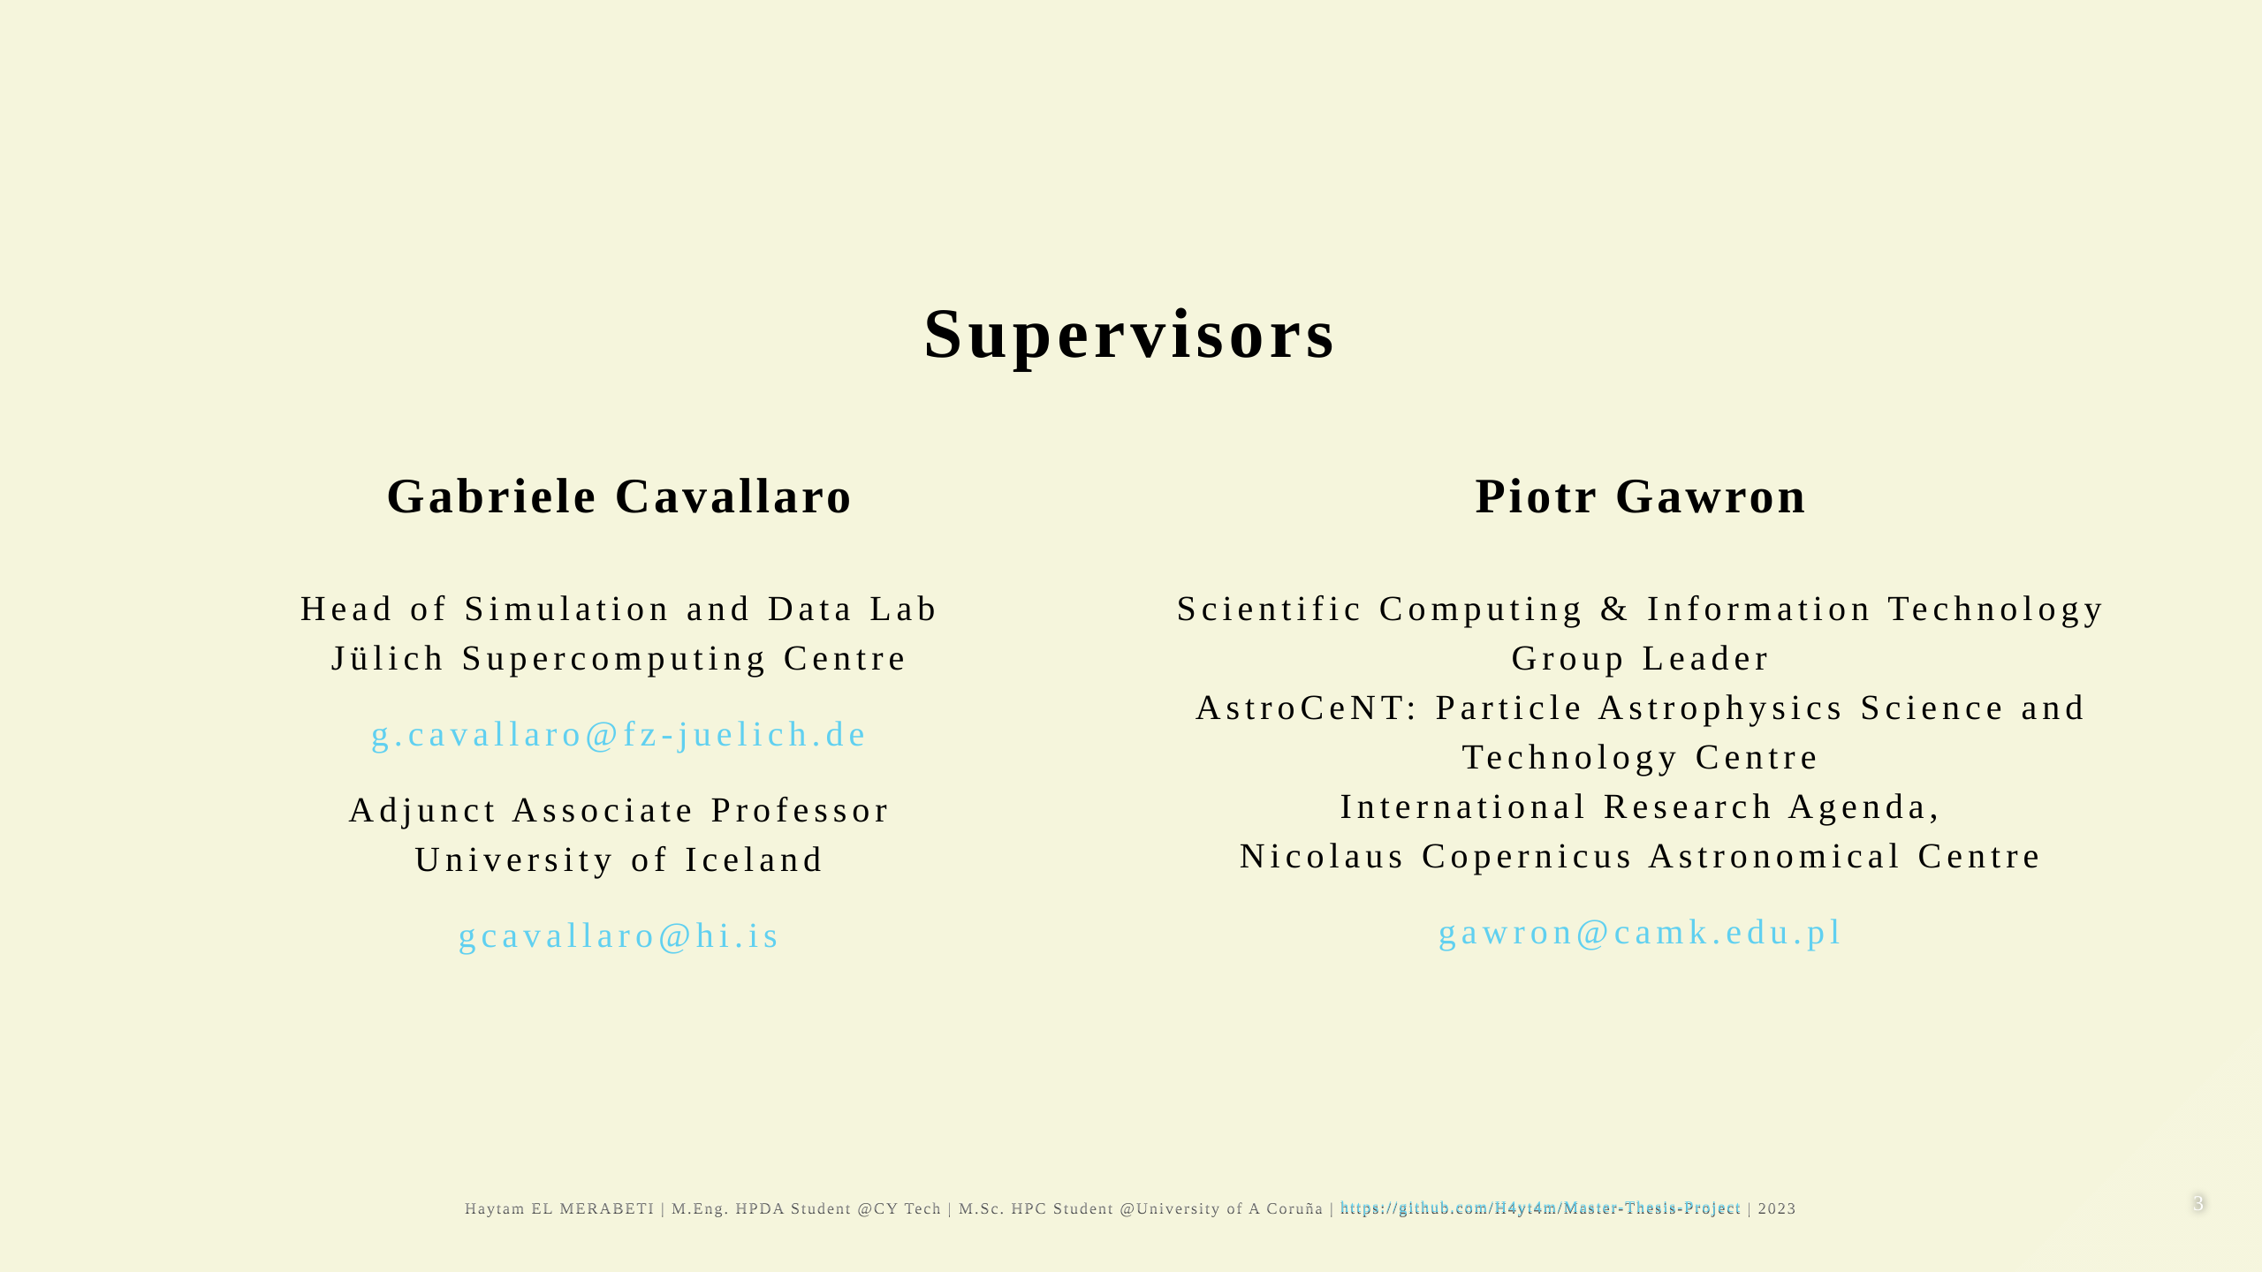

Slide 4
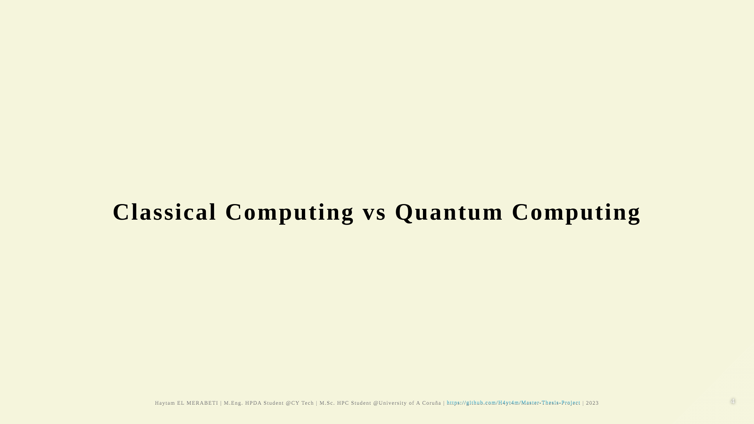

Slide 5
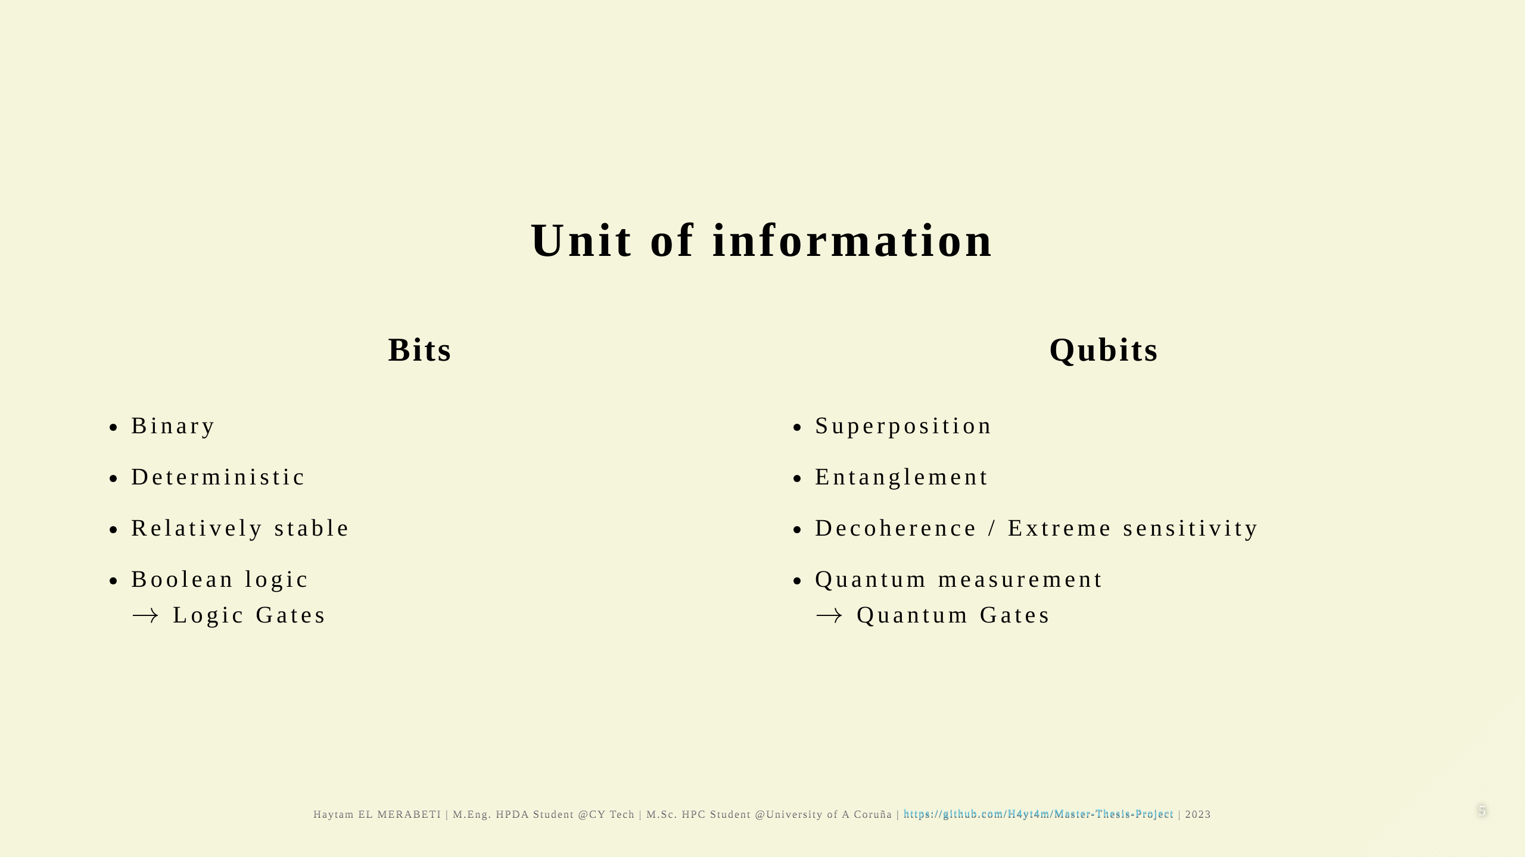
Notes:
# Unit of information _footer: "https://azure.microsoft.com/en-us/resources/cloud-computing-dictionary/what-is-a-qubit/#introduction" ![](qubit-vs-bit.jpg) ---

Slide 6
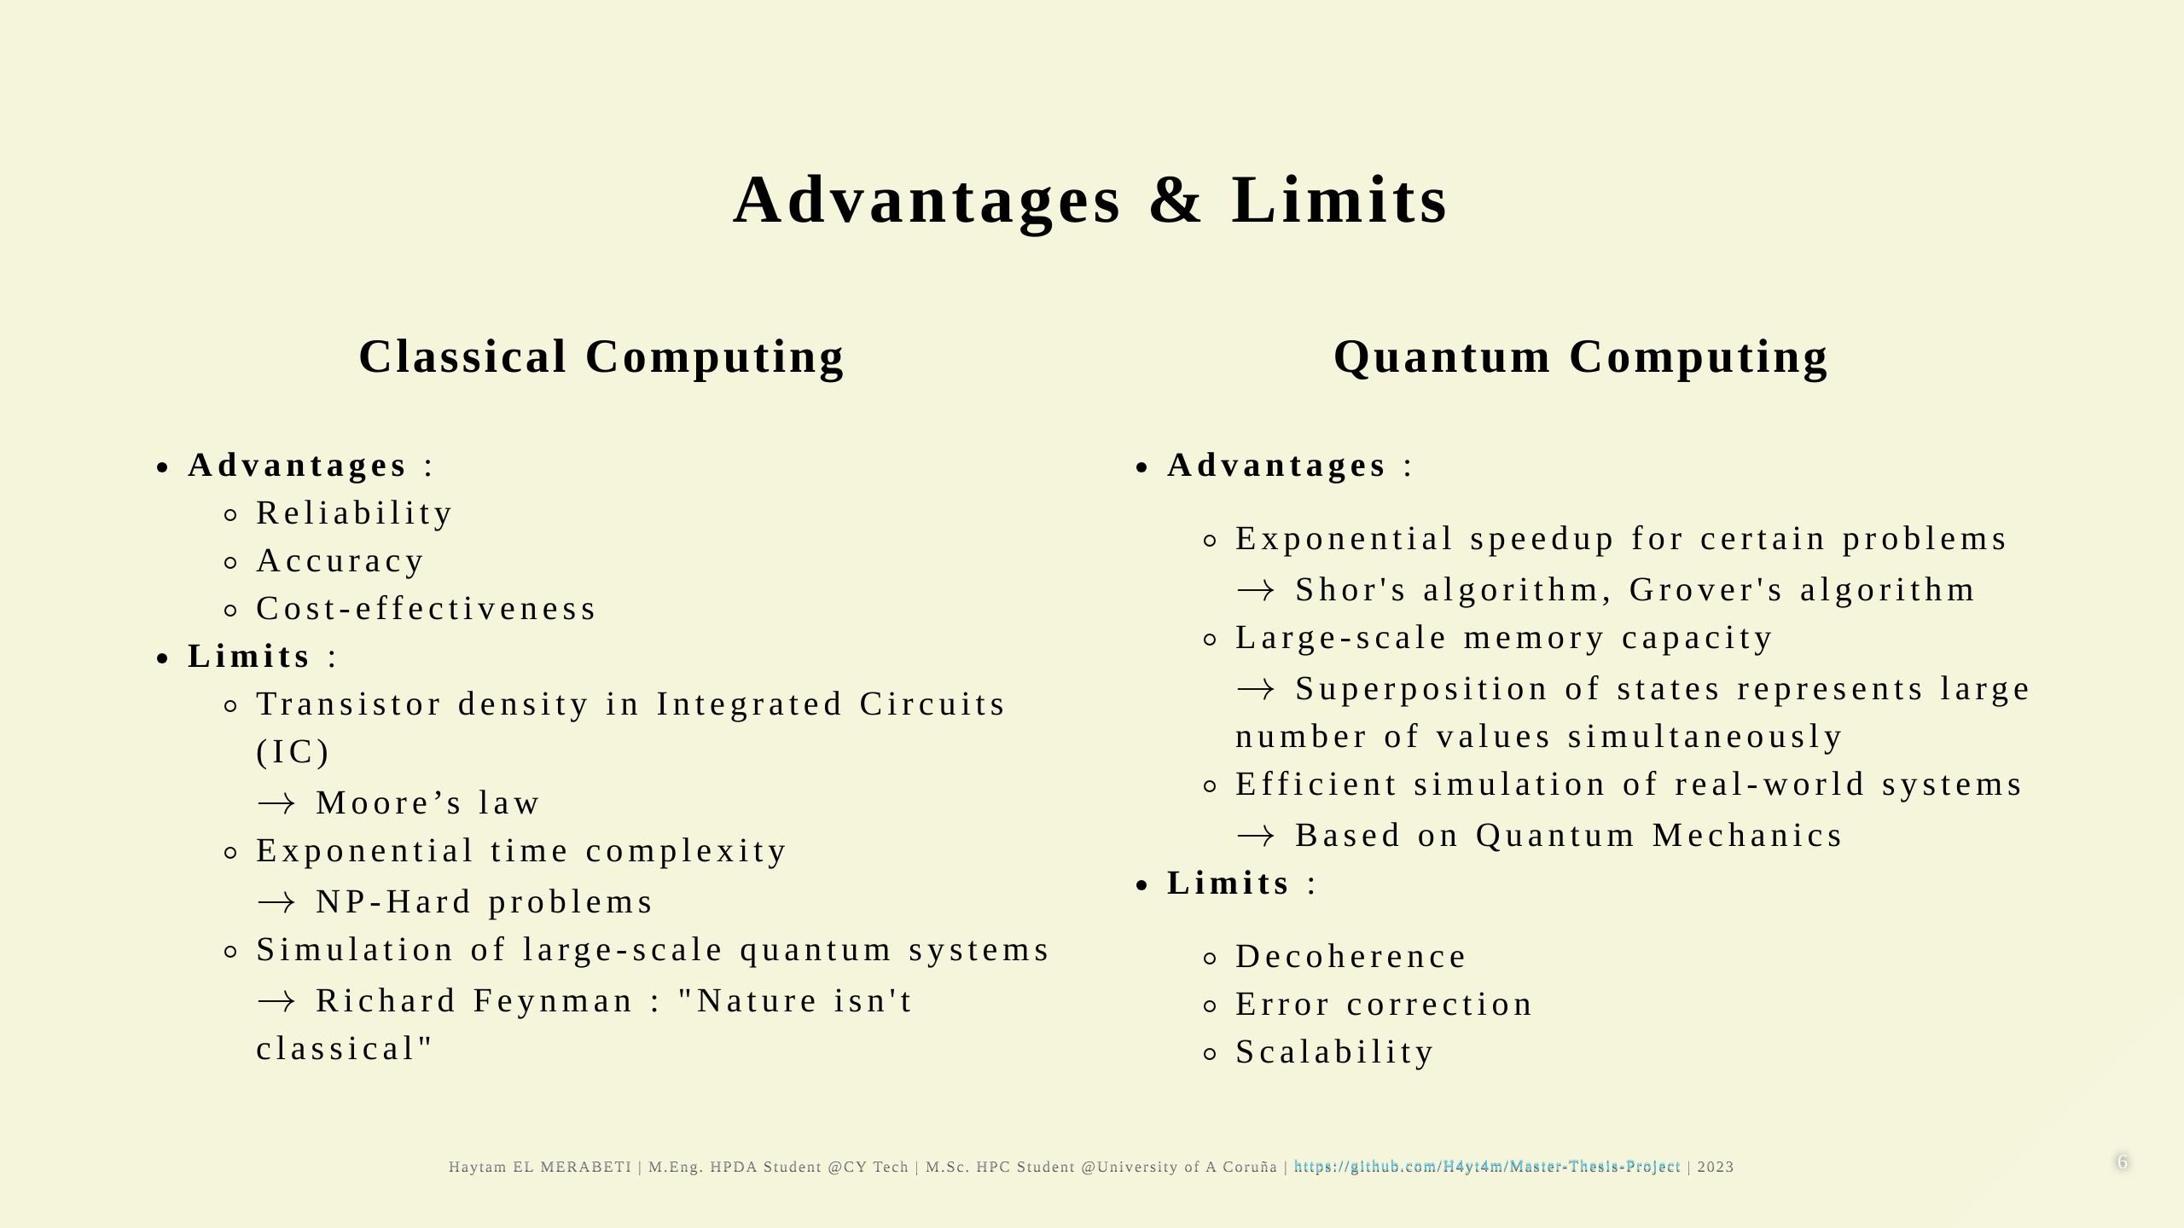

Slide 7
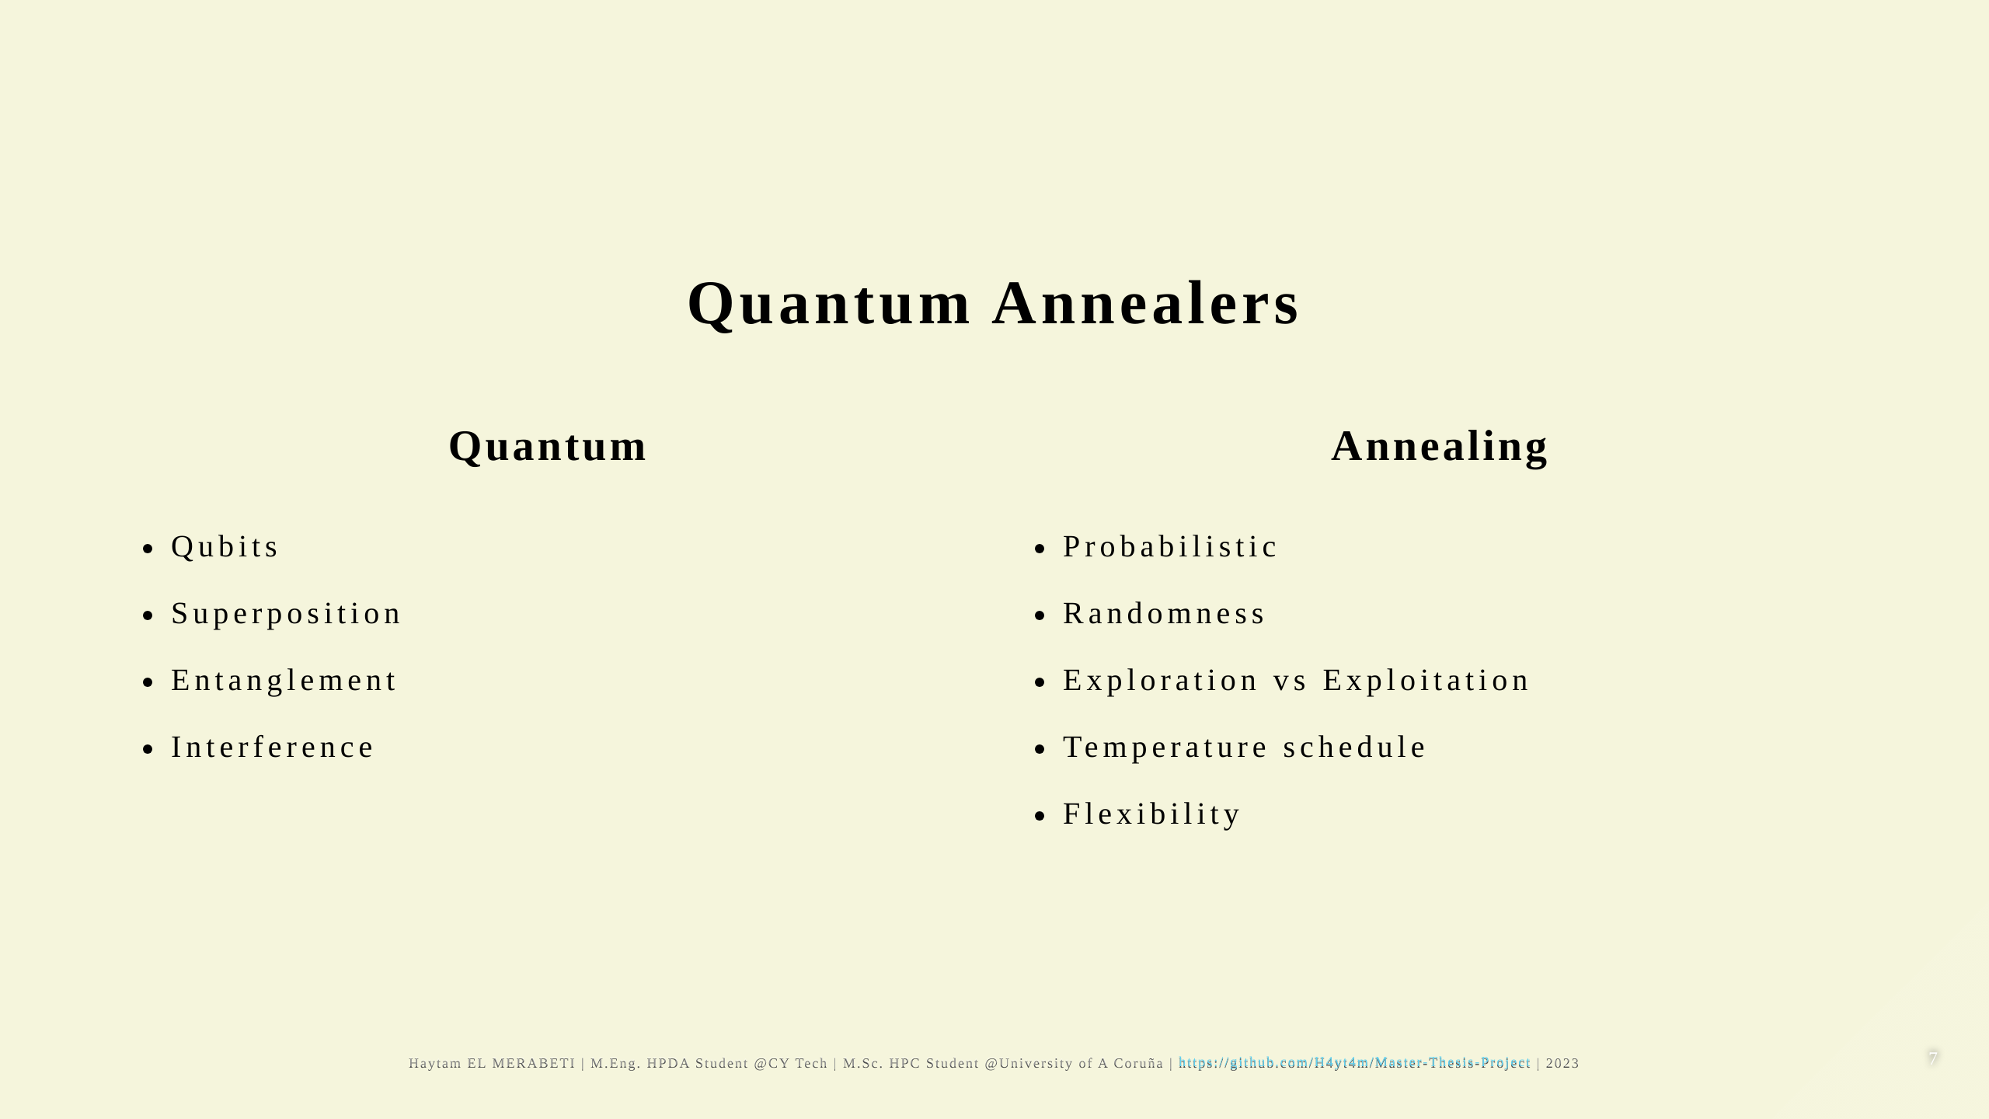

Slide 8
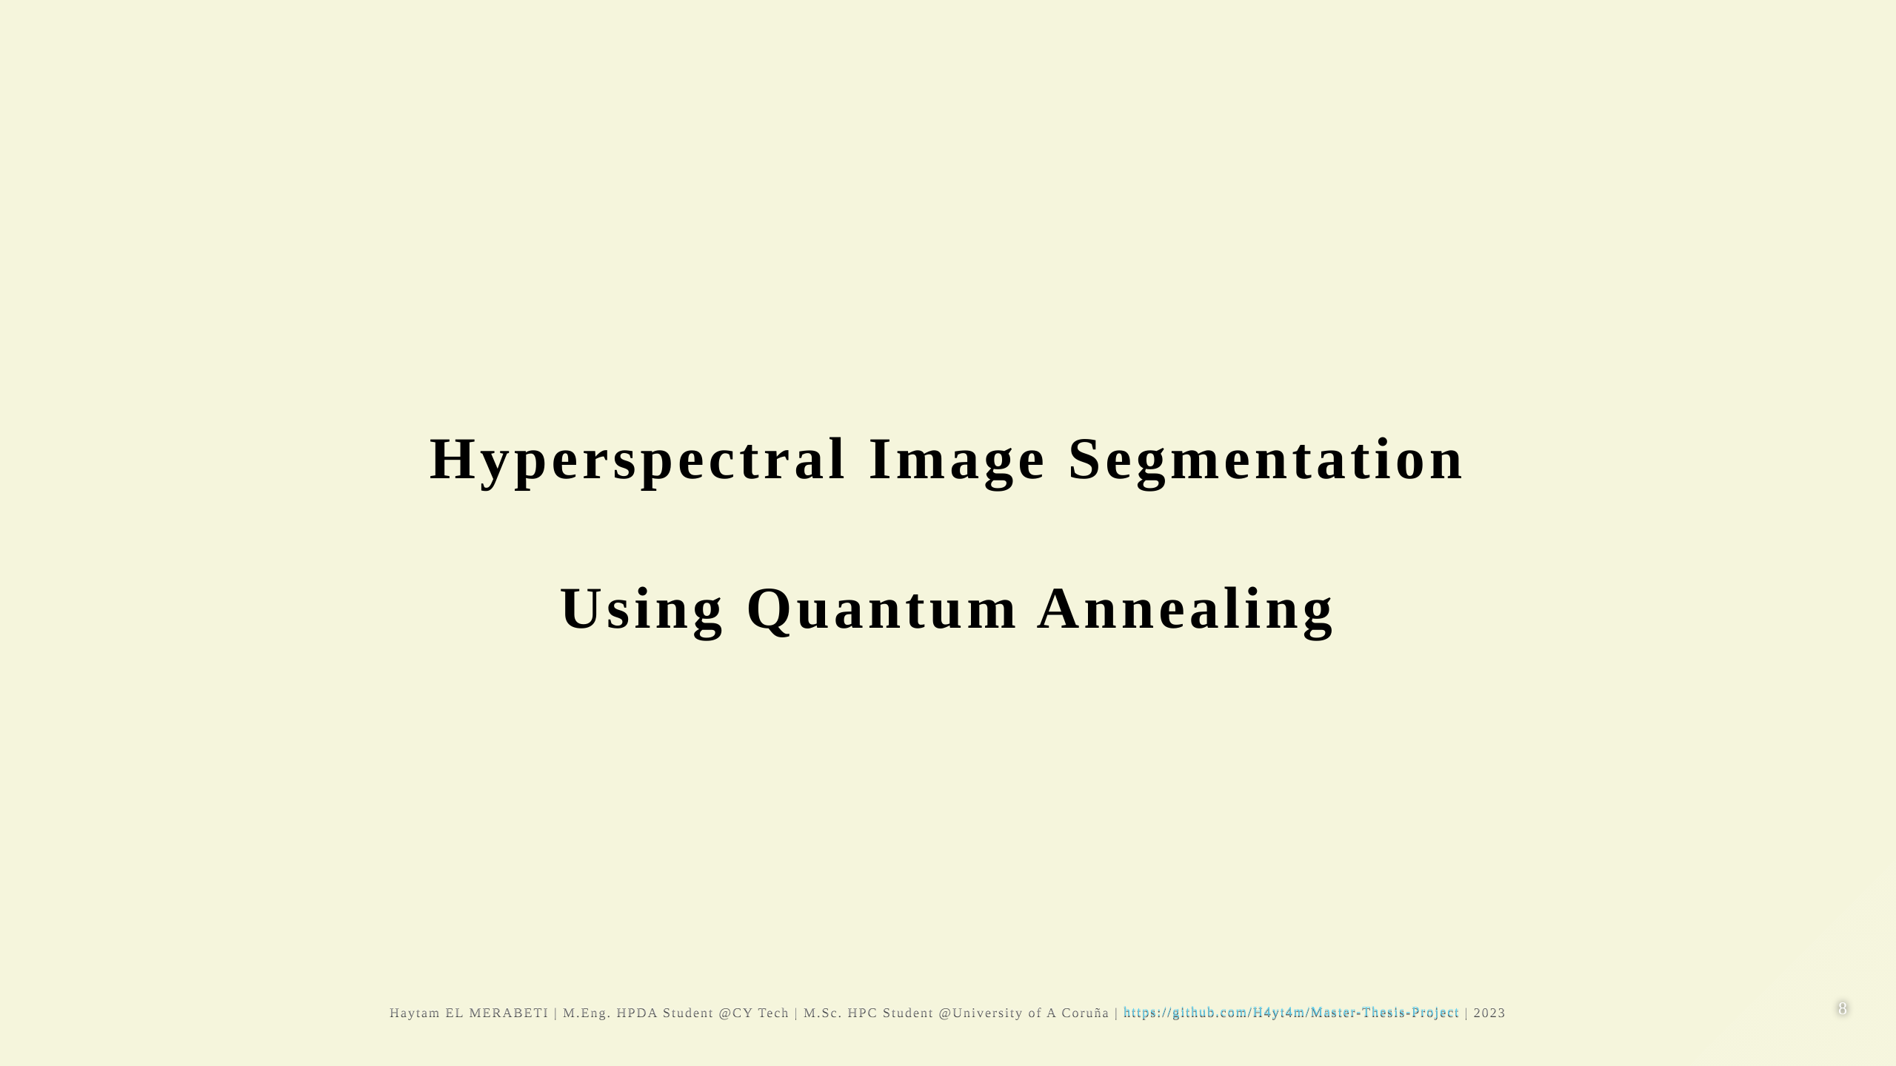

Slide 9
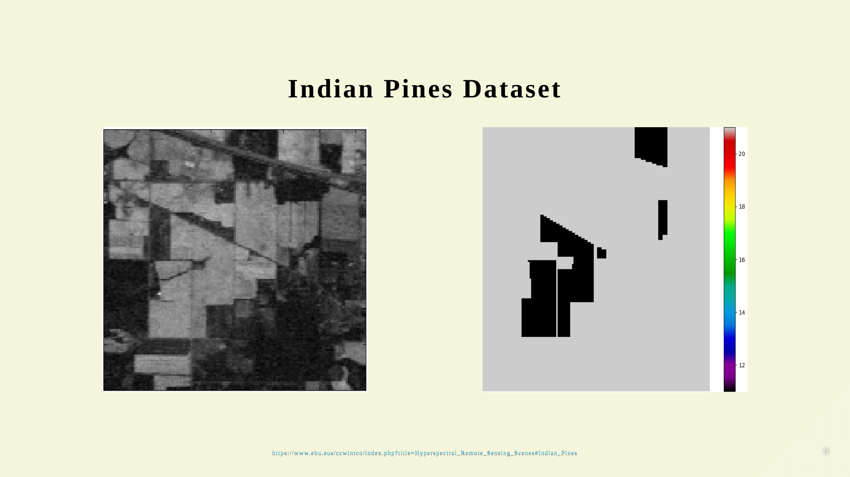

Slide 10
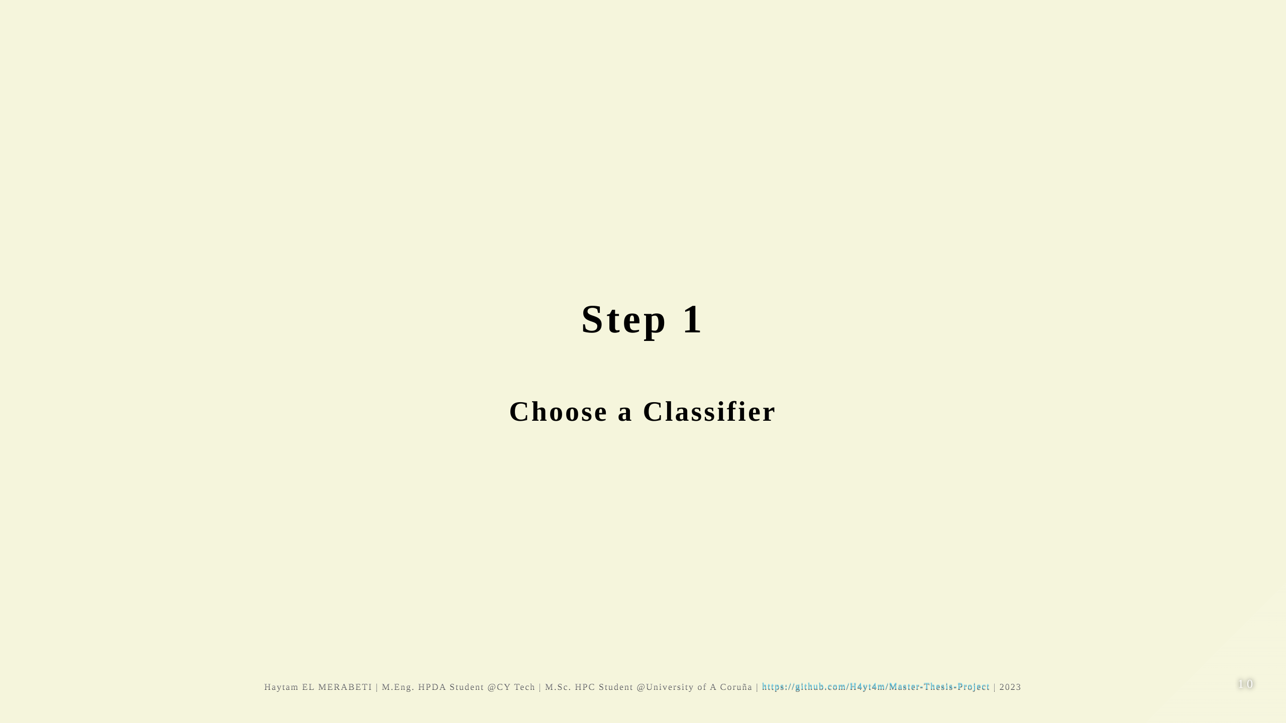

Slide 11
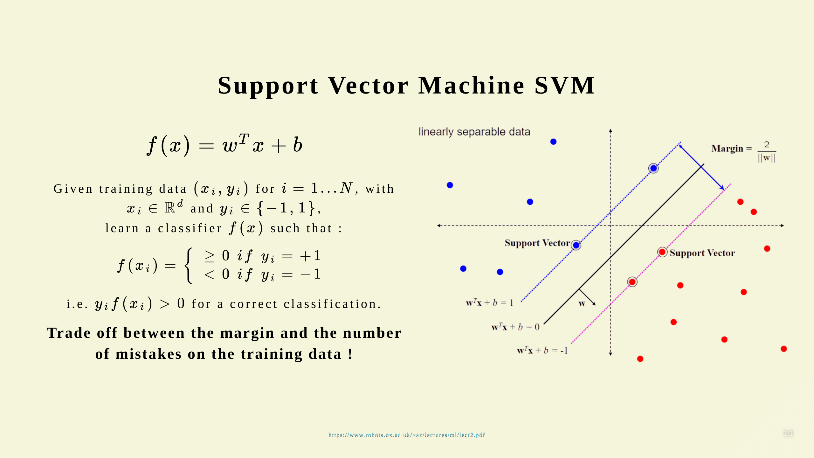

Slide 12
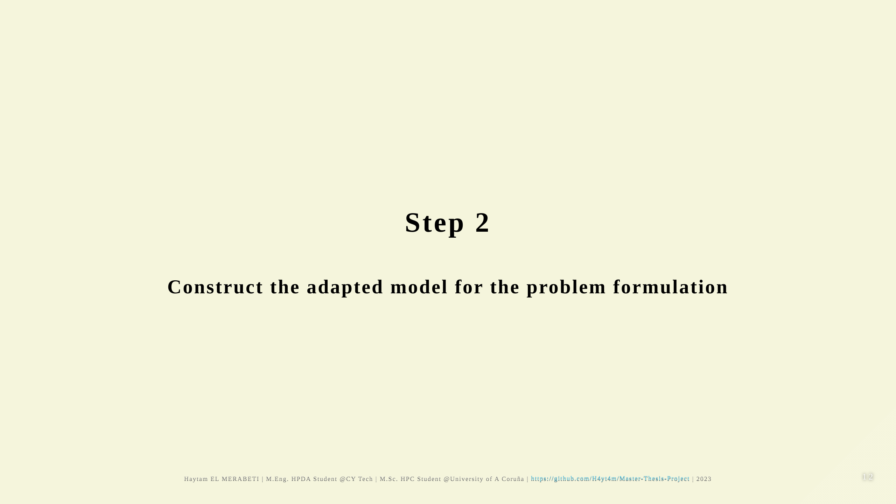

Slide 13
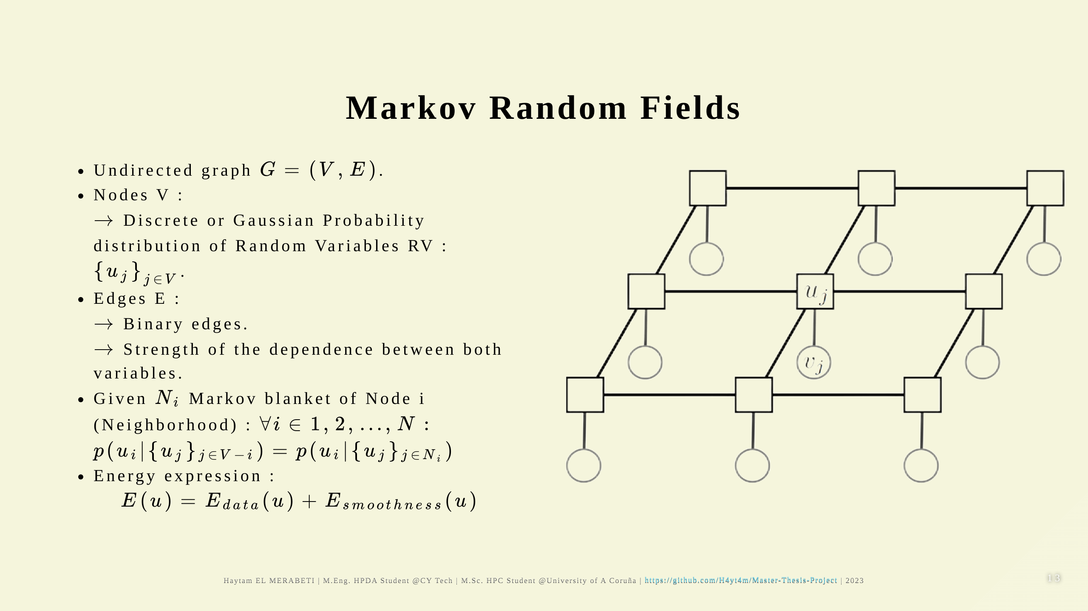

Slide 14
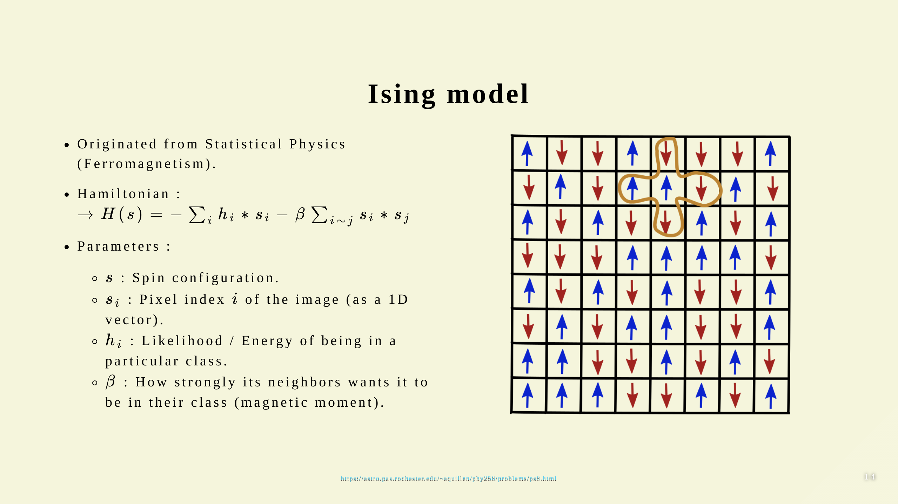
Notes:
### Two-dimensional square-lattice

Slide 15
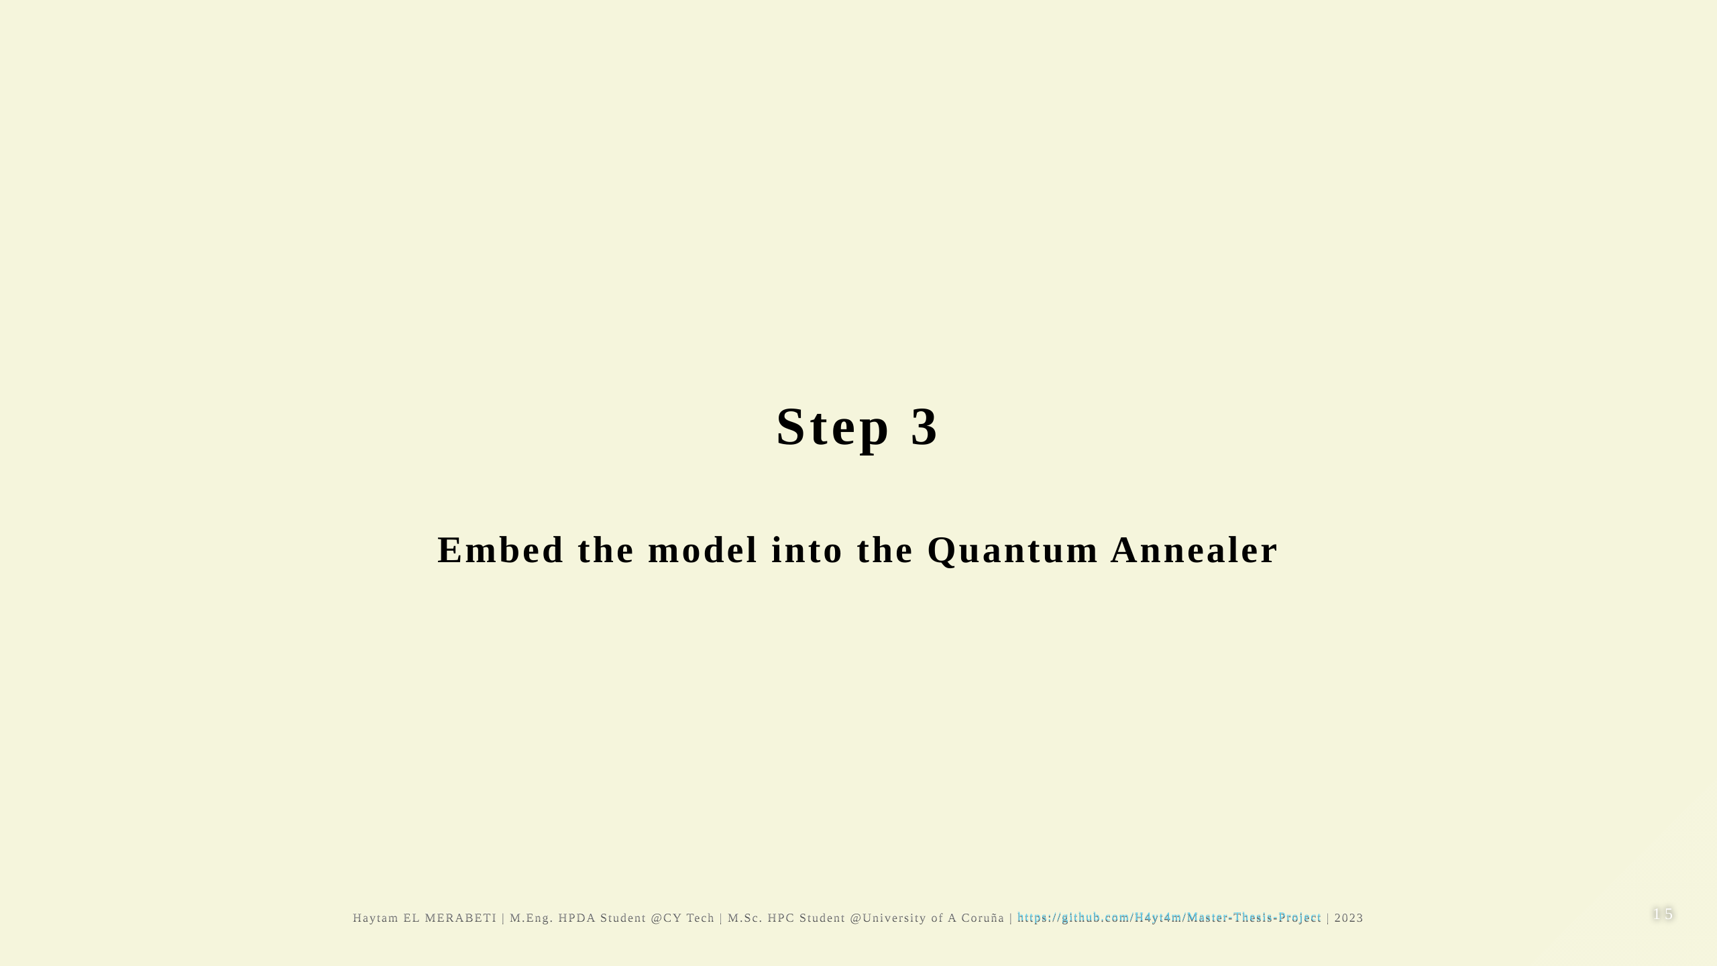

Slide 16
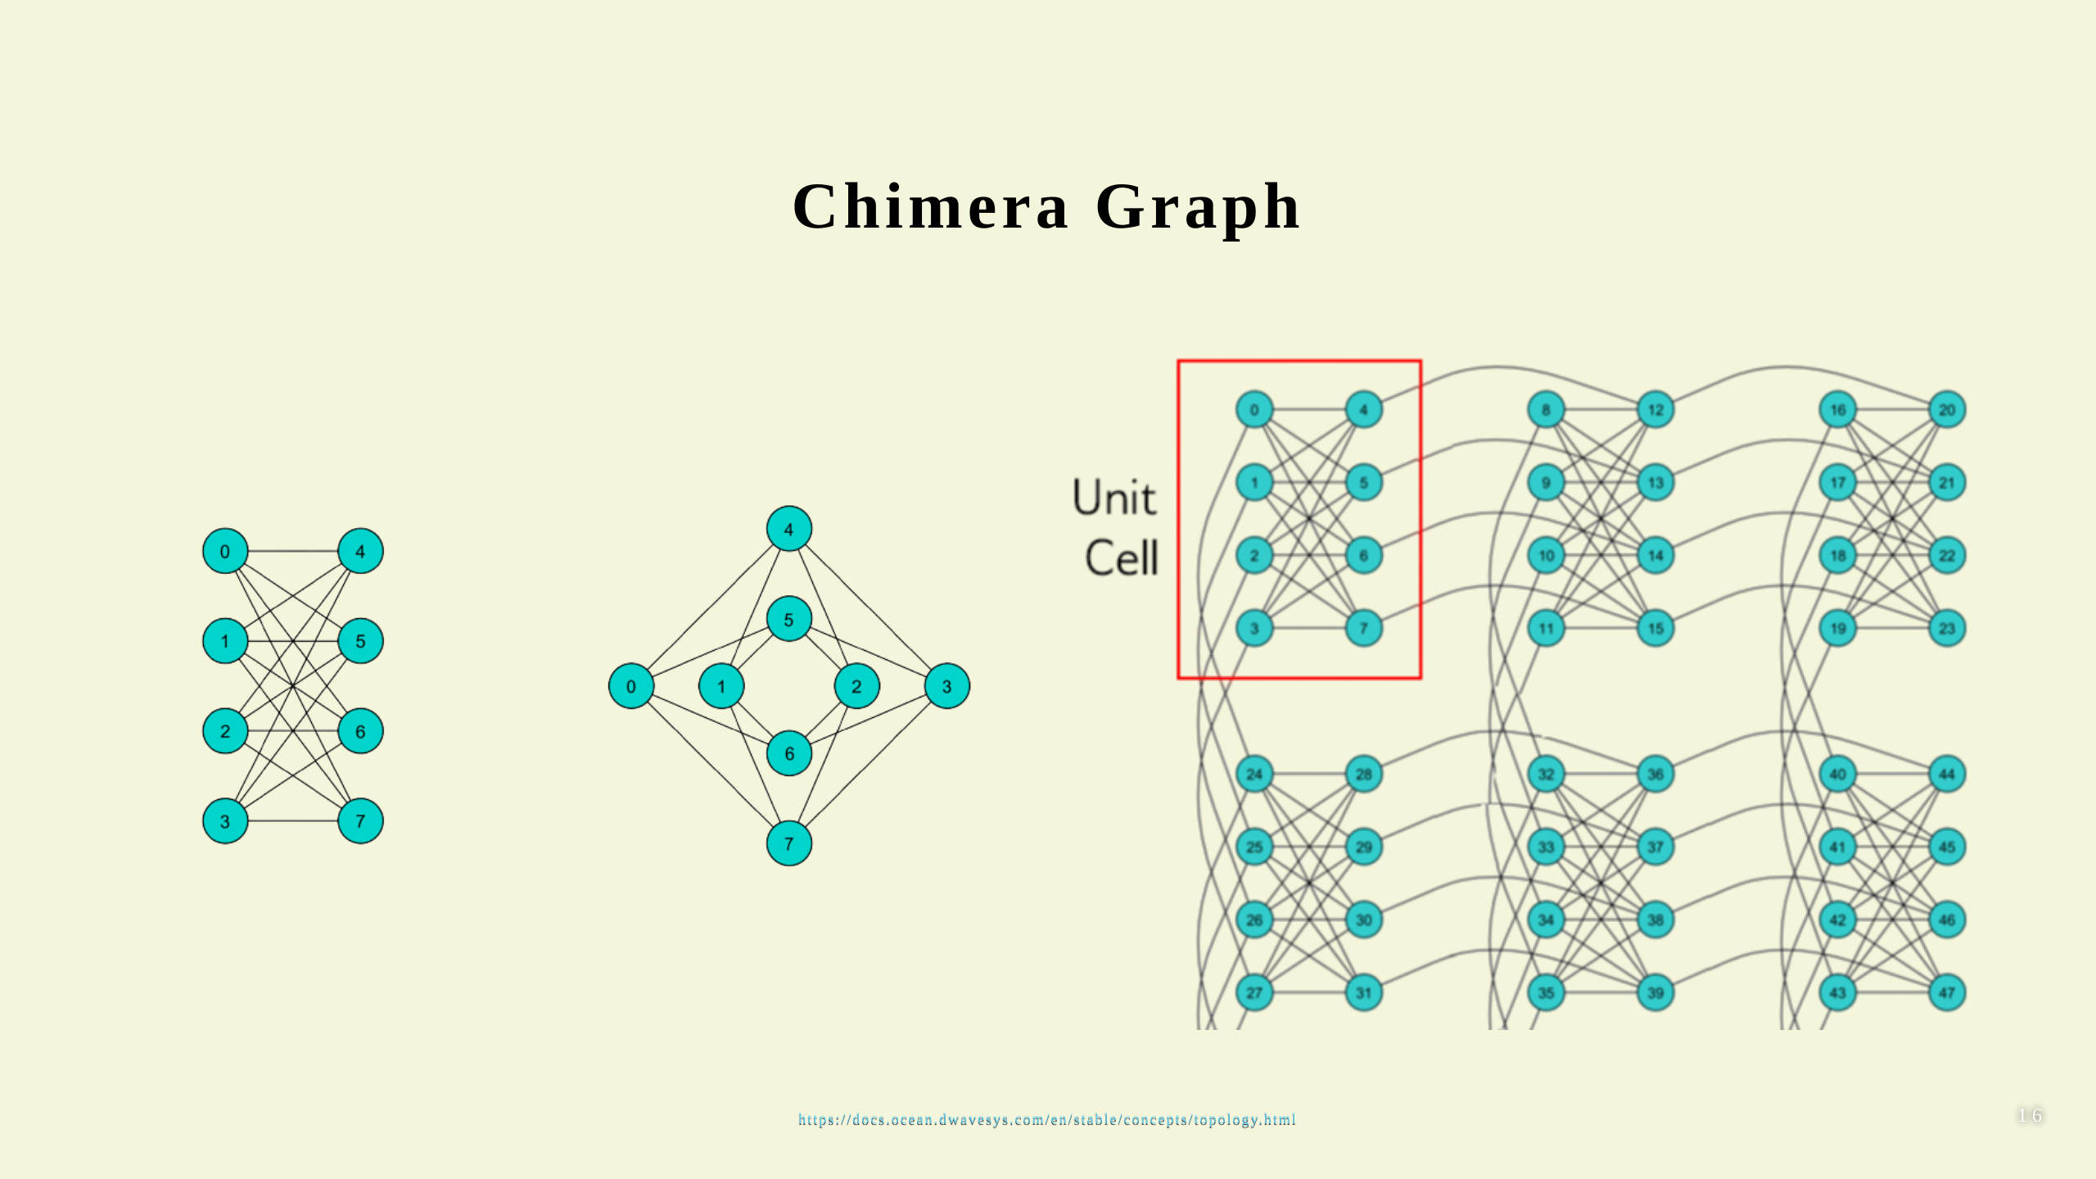
Notes:
- $(𝑀,𝐿)$ Chimera graph. - $2∗𝑀∗𝑀∗𝐿$ nodes (qubits). - Maximal degree of a given node is 6. - $𝑀∗𝑀$ cells (or subgraphs) in the grid. - $2L$ nodes per subgraphs, organized as bipartite.

Slide 17
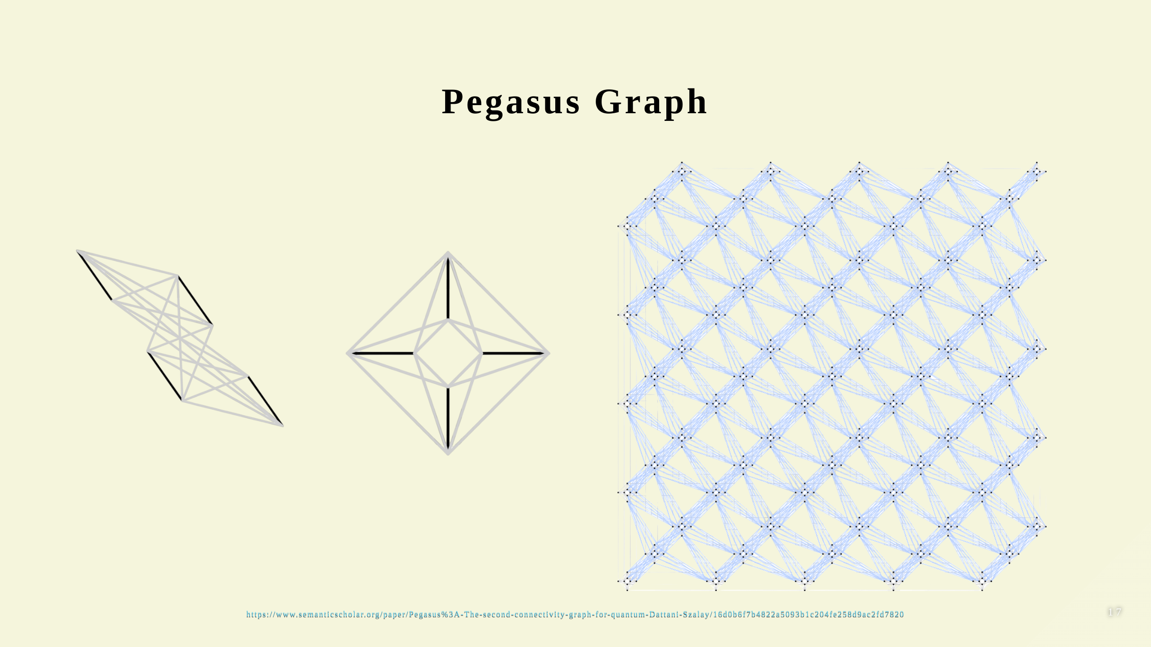

Slide 18
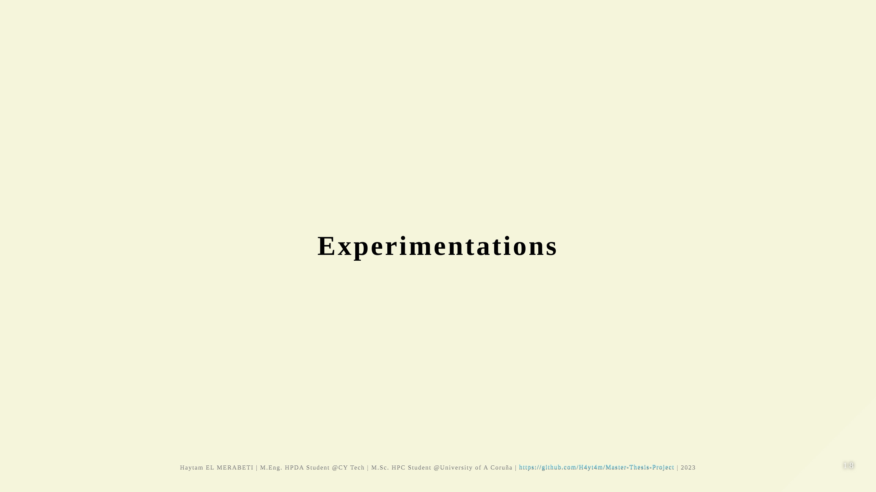

Slide 19
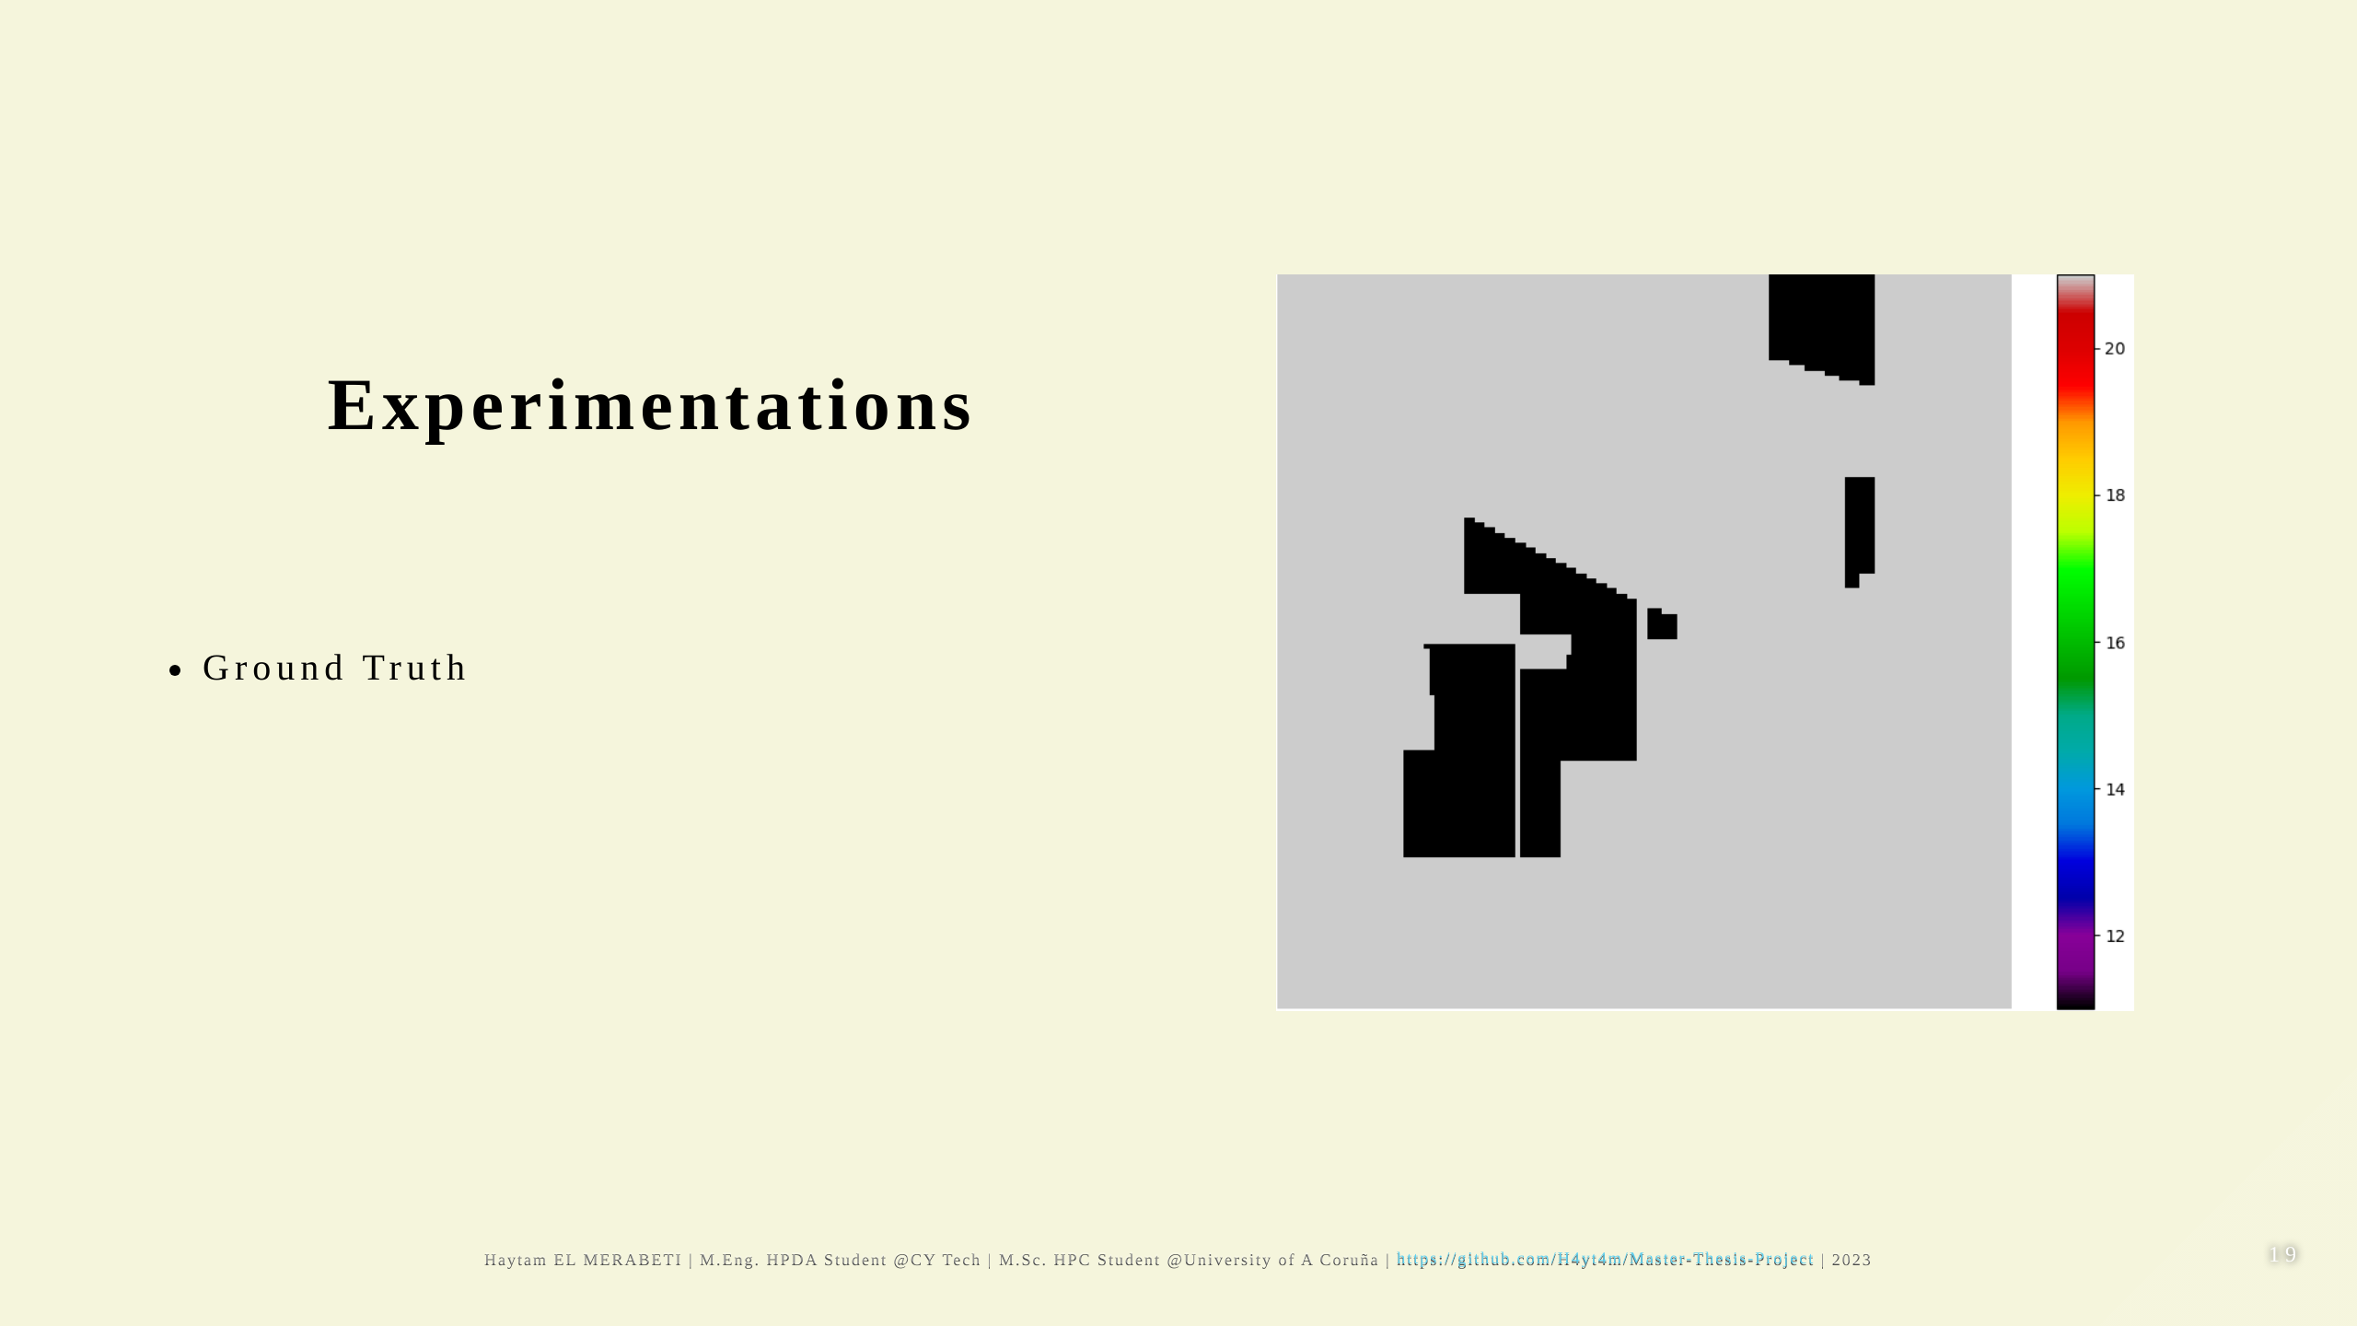

Slide 20
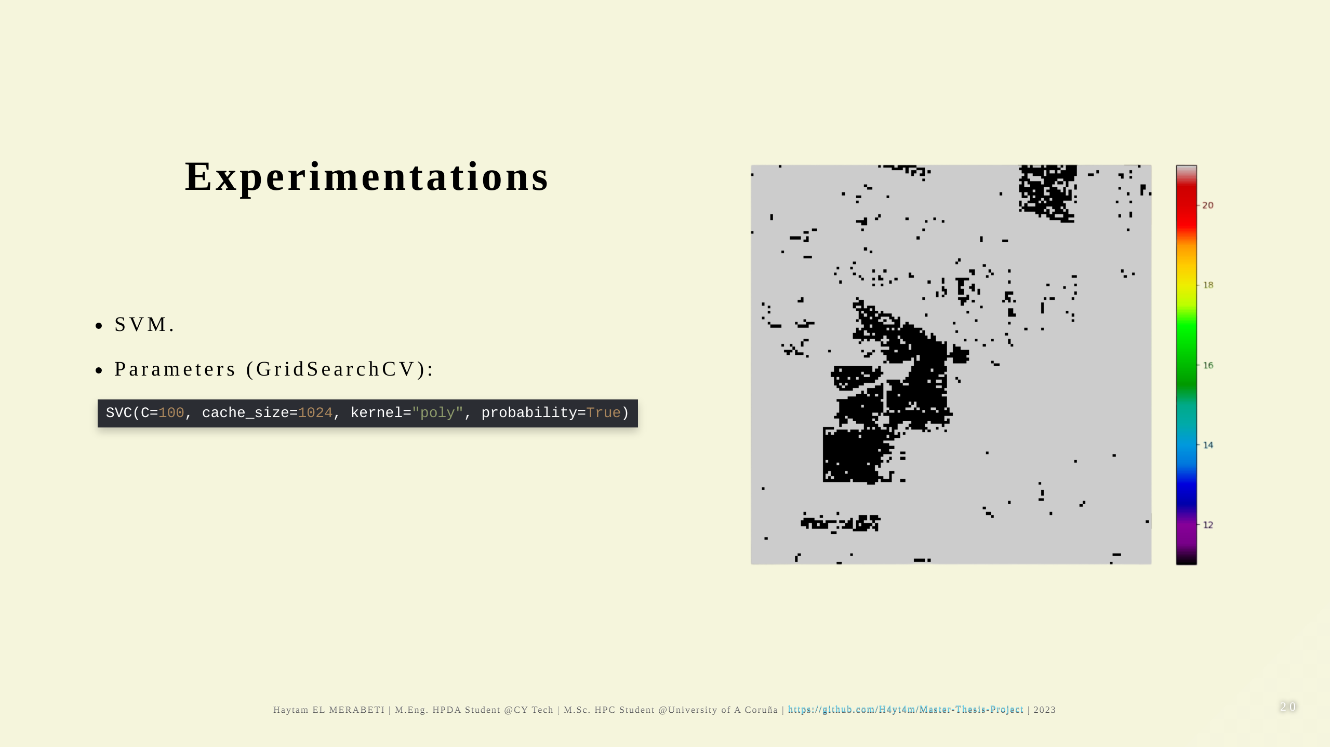

Slide 21
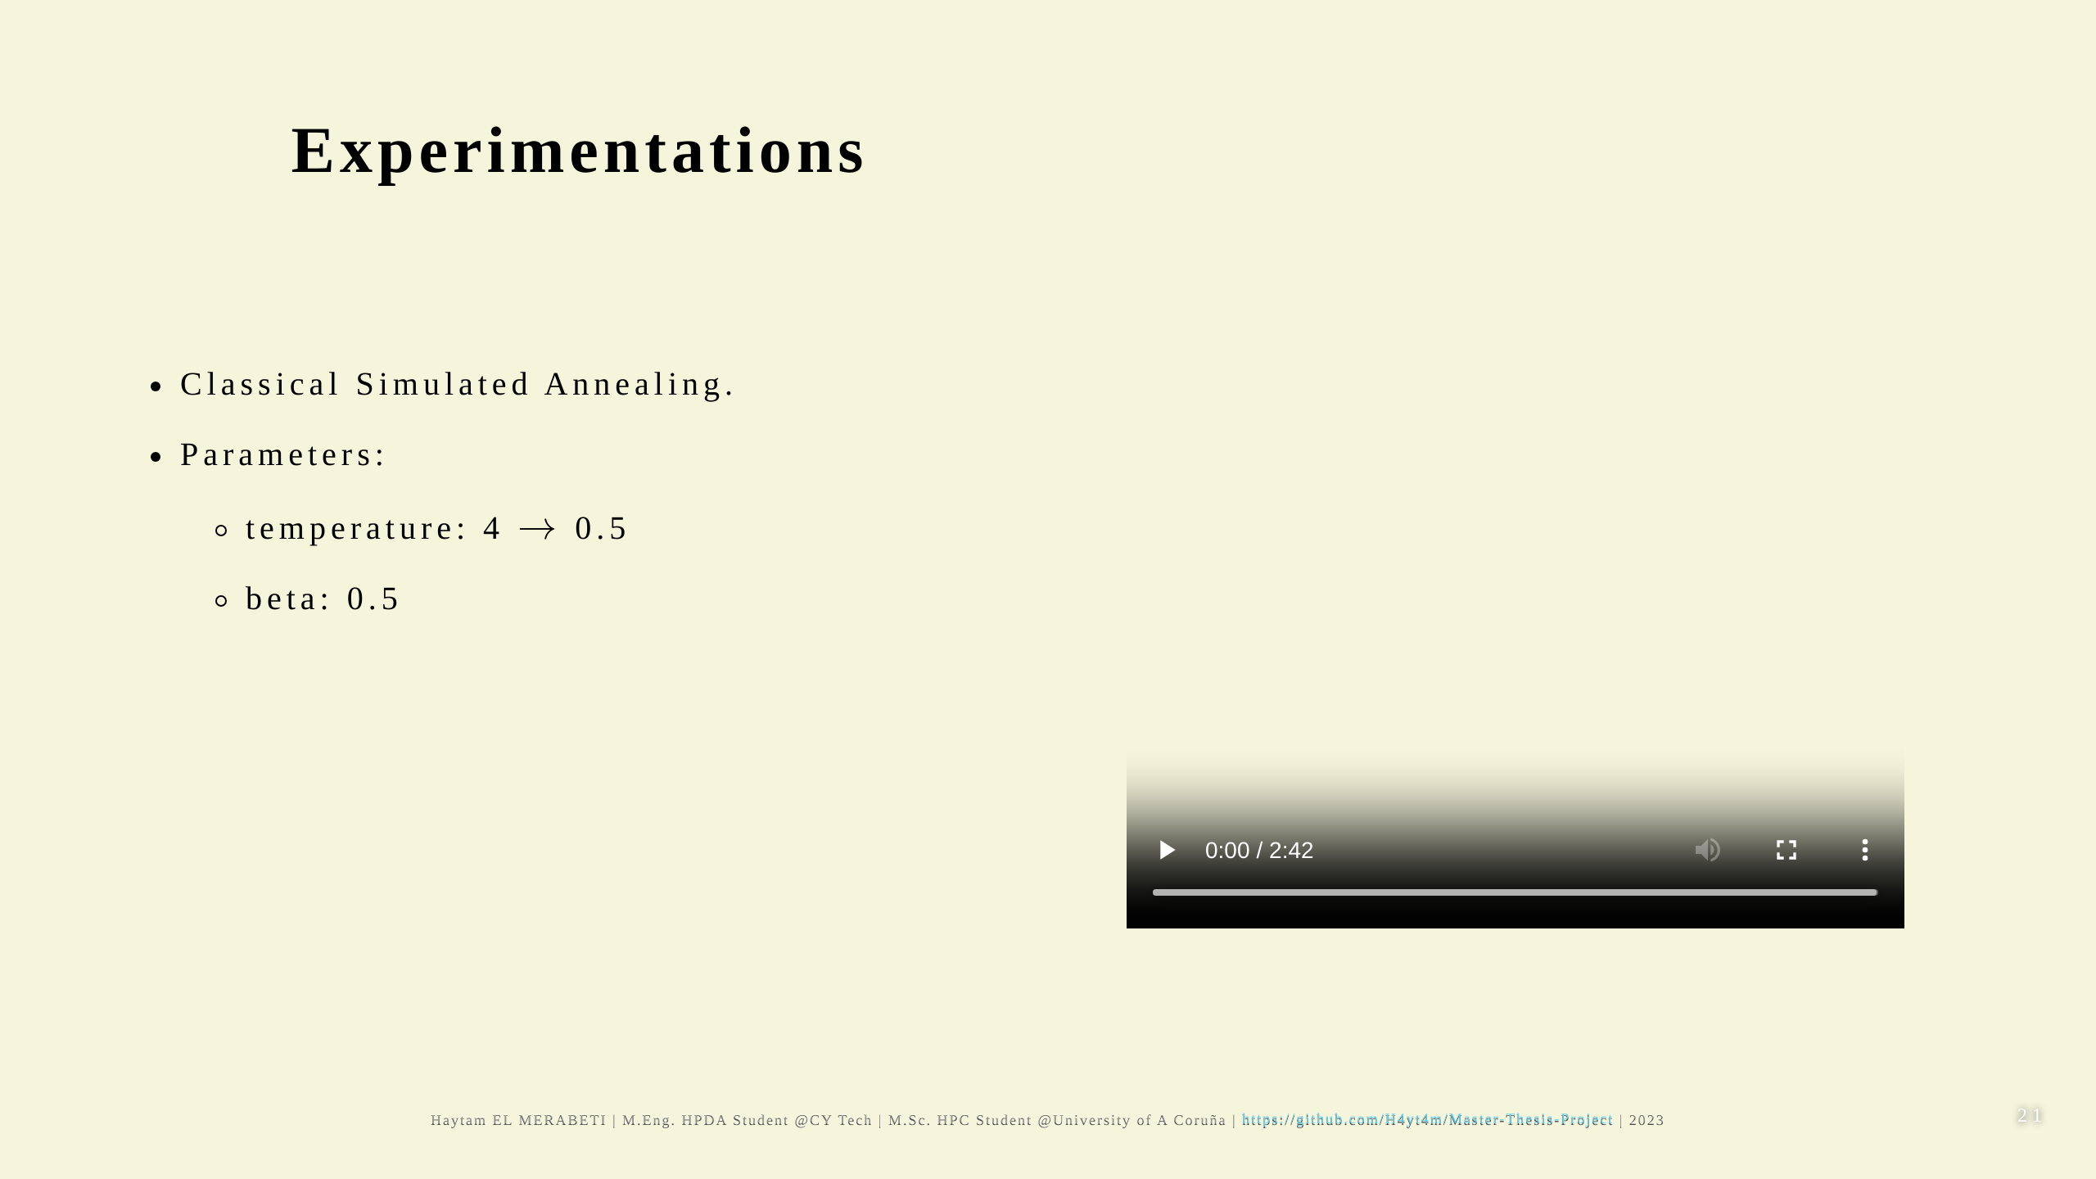

Slide 22
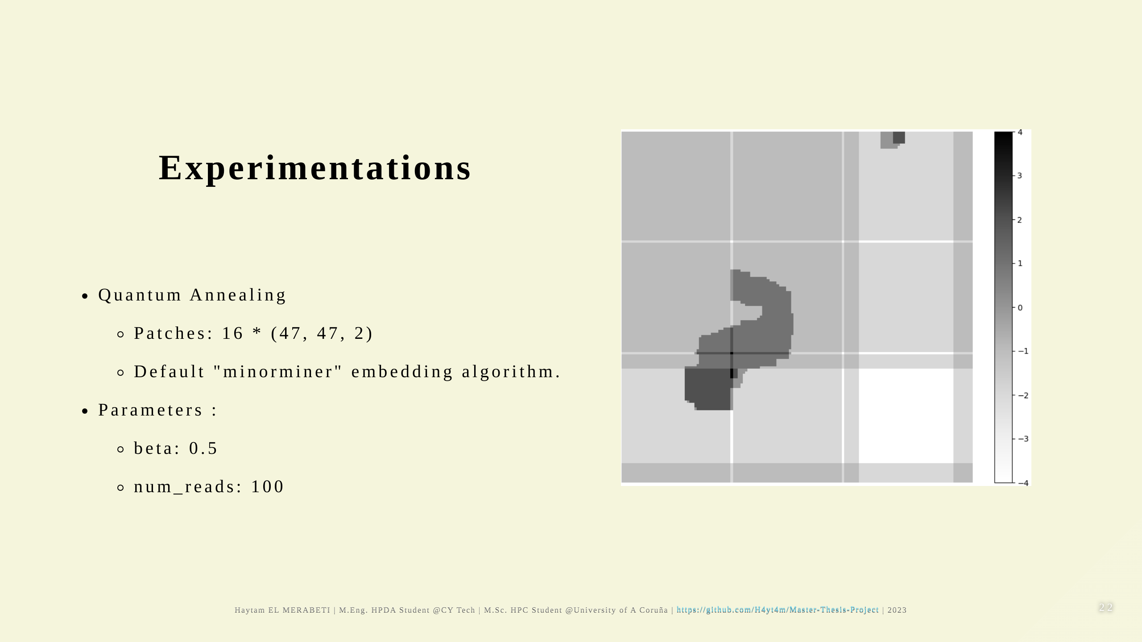

Slide 23


Slide 24
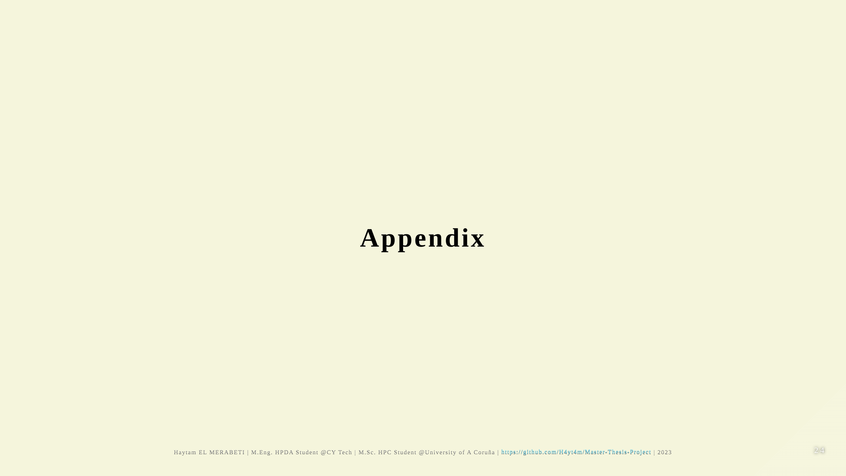

Slide 25
